Slide 1
Writing Paragraphs
Working organization for clarity and strong ethos

Slide 2
Paragraph writing and flow
What is flow? Logical story and connectors
Less organized because of the “story”
Nowadays ground water is polluted by industrial and agricultural works. Therefore, drinking tap water can lead to long term health problems. Further there is no guarantee regarding the safety and transportation of toxic chemicals and nuclear wastes. Polluted groundwater is a problem and we will focus on purification in our research.

Slide 3
More organized – story and connectors
Nowadays ground water is polluted by industrial and agricultural works. As a result, drinking tap water can lead to long term health problems. In fact, the world health organization estimates that there are no clean water sources left on the entire earth (source). Recent studies have, indeed shown that places as far away as the jungles of Central America and the Russian Tundra show worrying signs of ground water pollution (source). Hence, finding effective , ways to purify polluted water from a host of sources (chemical, nuclear, agricultural, etc.) proves more crucial than ever. Our research focuses on ground water pollution both from industrial and agricultural sources and the results are promising.

Slide 4
More organized – story and connectors
Nowadays ground water is polluted by industrial and agricultural works. As a result, drinking tap water can lead to long term health problems. In fact, the world health organization estimates that there are no clean water sources left on the entire earth (source). Recent studies have, indeed shown that places as far away as the jungles of Central America and the Russian Tundra show worrying signs of ground water pollution (source). Hence, finding effective , ways to purify polluted water from a host of sources (chemical, nuclear, agricultural, etc.) proves more crucial than ever. Our research focuses on ground water pollution both from industrial and agricultural sources and the results are promising.

Slide 5
How long should paragraphs be
Depends on the needs of the paragraph.
Usually, paragraphs are between one-third and two-thirds of a page double spaced (250 words).
A series of long paragraphs can make prose dense and unpleasant to read.
Check any paragraph that is a page or longer to see whether it would work better as two or more paragraphs.
Break it at a logical place (e.g., where your focus shifts), and see whether you need to create new topic sentences to make the shift clear.
Look out for short paragraphs only two or three sentences long.
They make academic writing seem disjointed or skimpy.
Try combining short paragraphs with the preceding or following paragraph if they share the same topic. Short paragraphs might also need to be developed further. Make sure that nothing vital has been omitted.

Slide 6
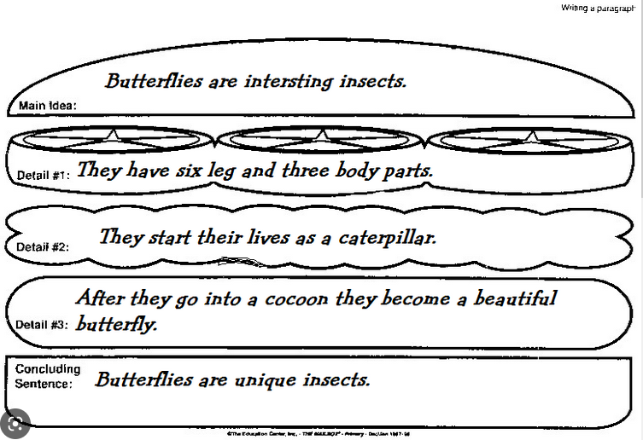
Keep it coherent and organized
Butterflies’ body structure and transformation are interesting. They start their lives as caterpillars, but do not stay that way for long. Soon, butterflies change, retreating into cocoons. Finally, they emerge as beautiful butterflies. At this stage, they present with six legs which are spread over three different body parts. In one short life span, these unique insects transform three times before becoming the beautiful creature we love watching.

Slide 7
In class exercise
Write at least 1 paragraph – stating a claim/opinion
Respond to a single point in “Importance of Stupidity”
Focus on writing a well organized, well connected paragraph.

