Slide 1
What is a “press release” and why is it important for you? http://pard.technion.ac.il/pard/ http://technionlive.technion.ac.il/Apr15/
“Press releases” are news articles that inform the world about the scientific advances by research universities. To write the press release, the Public Information Officer at the research university, like at the Technion for example, cooperates with the scientist.
Press releases mainly communicate important information to the press, who then publish in newspapers, TV, the internet to inform the public. It is important that the press release be interesting to catch attention

Slide 2
The press release has to fulfill three main goals
To increase public awareness of science and the scientific work
To increase public awareness of the research organization
To increase public awareness of specific scientific projects, instruments or missions

Slide 3
Tips for writing press release: Based on: http://www.mindtools.com/pages/article/writing-a-press-release.htm?utm_source=nl&utm_medium=email&utm_campaign=27Jan15#np

Slide 4
Who's my Audience?
When you know your audience, you also know how best to write and present your press release so that you get your message across.

Slide 5
The Headline
Most journalists receive a large number of emails every day, so your headline needs to grab their attention. It's worth spending time crafting it, because it will lead them either to read your press release or throw it away.
Keep your headline short, use active verbs, and accurately sum up what the whole story is about.

Slide 6
The First Paragraph
Your opening paragraph should summarize what is at the heart of your story. The seven key questions journalists want answered are:
Who? Where? When? Why?
What? How? How many?
Your opening paragraph should answer at least one of these questions, ideally more, and should contain enough information so that it can be published by itself if necessary.

Slide 7
The Main "Body" of the Release
Keep your sentences short and your language simple and accessible – avoid industry jargon or acronyms wherever possible.
Limit each paragraph to one point only, and structure them around the seven key questions, answering each question in turn in one or two sentences.
You might also want to include some relevant quotes in the press release. These should be short and to the point. If you have permission, it can be a good idea to include a quote from an expert or a senior colleague to add credibility to your release.

Slide 8
Add Your "Boilerplate" at the End
The boilerplate is essentially the "About Us" section of your press release, including:
the name and contact details of whoever is going to be dealing with follow-up enquiries
a "Notes for editors" section (describe what your company does, where it operates, when it was founded)
links to any further information that's available online.

Slide 9
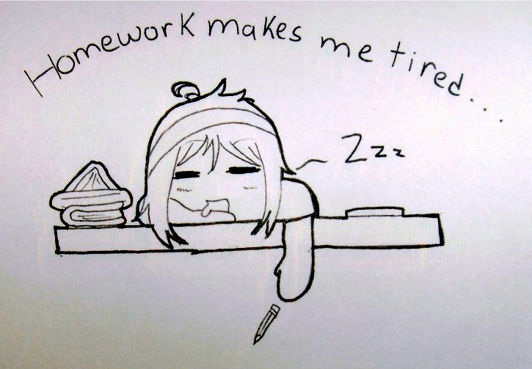
Thank you!
Don’t forget homework…..

