Slide 1
Parts of Speech

Slide 2
What are ‘parts of speech’?
Parts of speech are types of words which play different grammatical functions and usually have different forms.
What are the main parts of speech ?
- Verbs
- Nouns
- Adjectives
- Adverbs

Slide 3
Verbs (1)
* Verbs are words that denote either an action or a state.
E.g., run, clean (actions)
be, mean (states)
** A verb always has a tense (that is, grammatical time).
One can check whether a word is a verb by trying to change its tense.
If it works – this is indeed a verb. (For instance, ‘have’ can be changed into ‘had’, which means that ‘have’ is a verb).
If it does not work – it is a different part of speech.
*** Verbs can also appear as infinitives – in their basic form, preceded or not by ‘to’.
E.g., I asked my sister to help me with my English homework.

Slide 4
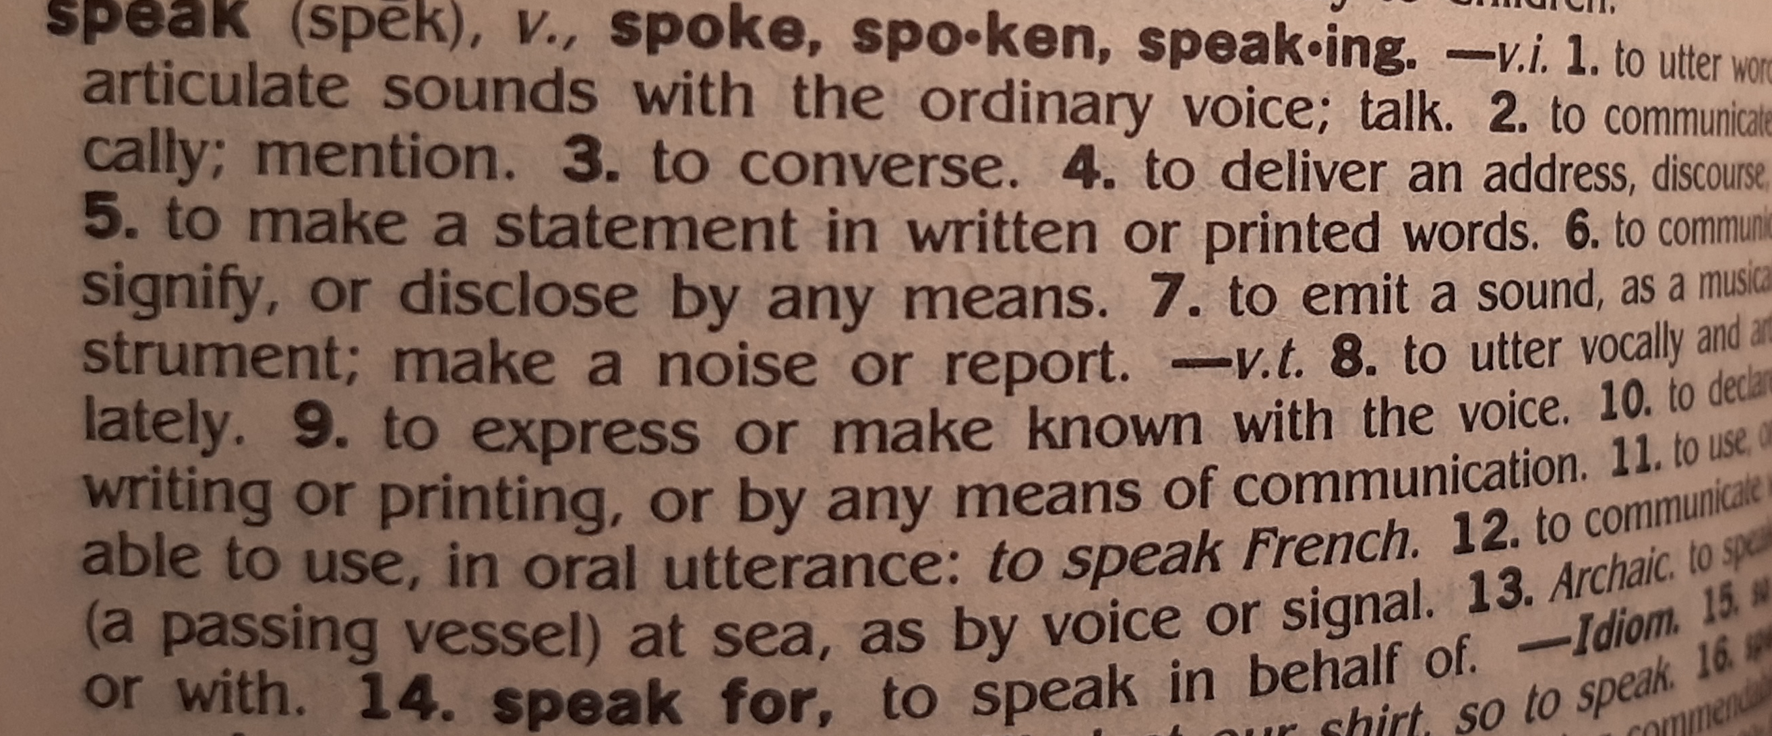
Verbs (2)
**** Unlike in many other languages, in English EVERY sentence must include a verb.
You may say that the whole sentence is anchored around the verb.
The dictionary indicates the part of speech of each word.
Verbs are indicated by a little v.
In online dictionaries you might find the whole name.
See, for example, https://www.oxfordlearnersdictionaries.com/definition/english/speak_1?q=speak

Slide 5
Verbs (3) – Identifying verbs in a passage
Read the first paragraph of the text “The World Language” (Unit 1).
Mark all verbs.
“On the estimates of David Crystal, a British expert, some 350 m people speak English as their first language. Between 250 m and 350 m, do or can use it as a second language. And elsewhere? That is a heroic guess, and it largely depends on how you define "can". Let us be bold: in all, 20-­25% of earth's 6 billion people can use English .”
What is the tense of each of these verbs? Why does the author use this tense?

Slide 6
Nouns (1)
* Nouns are words that denote something or someone.
Therefore, they answer the questions of ‘what’ or ‘who’.
E.g., a student, a desk, information
** Nouns can be either common or proper.
Common nouns refer to general entities (e.g., a student, a university, a city).
Proper nouns refer to specific entities (e.g., Sharon, the Technion, Haifa).

Slide 7
Nouns (2) – Countable and Uncountable Nouns (A)
Nouns can be either countable or uncountable.
Countable nouns have the following characteristics:
1. They can be counted, that is, they have both a singular and a plural form.
[e.g., a student, students]
2. If they are singular, they must be preceded by an article:
A. General (or indefinite) nouns – those mentioned for the first time - are preceded by the articles a (for nouns starting with a consonant) or an (for nouns starting with a vowel – i.e., a, e, i, o u).
E.g. a student , a desk, an ambulance
B. Specific (or definite) nouns – those mentioned before in the text - are preceded by the article the (or this, that)
E.g. the student, this man

Slide 8
Nouns (3) – Countable Nouns (B)
3. Plural countable nouns are preceded by an article only if they are specific (definite).
E.g. The students who study at the Technion are talented.
* No article is used for general (indefinite) plural nouns:
E.g. In Israel, students are required to study English in high school.
***Proper nouns are usually NOT preceded by any article:
E.g. I live in X Haifa.
She voted for X Joe Biden.
Now let’s try a short exercise: https://www.liveworksheets.com/worksheets/en/English_as_a_Second_Language_(ESL)/Definite_and_Indefinite_Articles/Choose_the_correct_answer*_a_-_an_-_the_jz11517sm

Slide 9
Nouns (4) – UNCountable Nouns
Uncountable nouns have the following characteristics:
1. They have only one form, which is grammatically singular.
E.g. Water is very important for one’s health.
2. They are preceded by an article only if they are specific (definite):
E.g., The water in this house is too sweet.
3. General (indefinite) uncountable nouns are NOT preceded by any article:
E.g., In our age, X information is considered very important.

Slide 10
Nouns (5) – Countable vs. Uncountable Nouns temporary summary
Uncountable | Countable
1. One form | 1. Two forms – singular and plural
2. Articles: General Specific no article the | 2. Articles: Singular Plural General Specific General Specific a / an the no article the
Now let us try another exercise:
https://www.english-grammar.at/online_exercises/articles/article2.htm

Slide 11
Nouns (6) – Quanitifiers (A)
Quanitifiers are words which denote a quantity.
We use different quanitifiers for countable and uncountable nouns:
Uncountable (AMOUNT) | Countable (NUMBER)
much Some a little little | many some several a few few
For example, we say ‘many students’ but ‘much information’.

Slide 12
Nouns (7) – Quanitifiers (B)
A few vs. few and a little vs. little – These quantifiers show the speaker’s attitude towards the quantity s/he refers toThe
When ‘a’ appears before the quantifier (either few or little), it refers to an objective quantity and tends to have a positive meaning.
E.g., I have a few friends and they make me feel beloved.
I have a little money so I can buy a new coat.
By contrast, when these quantifiers appear without the ‘a’, this indicates a lack and tends to have a negative meaning. It means, almost nothing or none.
E.g., I have few friends and therefore I feel lonely.
I have little money so I buy only cheap food.
://
:/
https://www.tolearnenglish.com/exercises/exercise-english-2/exercise-english-29182.php
Check the exercises in the following slide --->

Slide 13
Quantifiers - Exercises
Now, please try the following exercise on a little, little, a few or few: https
https://www.tolearnenglish.com/exercises/exercise-english-2/exercise-english-29182.php
And then this one, on different quantifiers:
https://www.tolearnenglish.com/exercises/exercise-english-2/exercise-english-4654.php

Slide 14
Nouns (9) – common endings (suffixes)
Each part of speech has characteristic endings, also called ‘suffixes’.
Some of the most common noun suffixes are:
-tion (or: -sion) - as in nation, possession, passion
-ment – as in department, enjoyment
-ance or –ence as in importance, dependence
-ity – as in quality, ability
-hood – as in neighborhood, adulthood
Being familiar with such endings may help us identify a noun in the text.
**Can you think of additional examples for each ending?

Slide 15
nouns (10) – Identifying nouns in a passage
Now let us re-read the first paragraph of the text “The World Language”.
Mark all nouns.
“On the estimates of David Crystal, a British expert, some 350 m people speak English as their first language. Between 250 m and 350 m, do or can use it as a second language. And elsewhere? That is a heroic guess, and it largely depends on how you define "can". Let us be bold: in all, 20-­25% of earth's 6 billion people can use English .”
For each noun, state whether it is countable or uncountable.

Slide 16
Nouns (11) – how they look in the dictionary
Nouns are indicated by a little n. The dictionary also indicates whether a given noun is countable or uncountable. [uncountable – U/ UC / MASS]
See, for example:
https://www.oxfordlearnersdictionaries.com/definition/english/language?q=language
language
noun n
OPAL WOPAL S
/ˈlæŋɡwɪdʒ/
/ˈlæŋɡwɪdʒ/
Idioms
of a country
​[countable[
the system of communication in speech and writing that is used by people of a particular country or area

Slide 17
Nouns (12) – the use of pronouns
When an author or a speaker does not wish to repeat the noun s/he has just mentioned, s/he uses a PRONOUN – a word which replaces the noun.
Pronouns replacing nouns functioning as subjects in the sentences have the following forms: I, you, he, she, it, we, they
Pronouns replacing nouns functioning as objects in the sentences have the following forms: me, you, him, her, it, us, them
Possessive pronouns have the following forms : my, your, his, her, its, our, their
In our paragraph, the following are all pronouns:
“On the estimates of David Crystal, a British expert, some 350 m people speak English as their first language. Between 250 m and 350 m, do or can use it as a second language. And elsewhere? That is a heroic guess, and it largely depends on how you define "can". Let us be bold: in all, 20-­25% of earth's 6 billion people can use English.”
* Which nouns do the highlighted pronouns refer to?

Slide 18
Nouns and Verbs having the same form
There are cases when the nouns and verbs of the same “word family” have the same form.
E.g., the word ‘design’ may function as either a noun or a verb, depending on the context.
1. They design public buildings.
2. The design of the building is modern.

Slide 19
Adjectives (1)
* Adjectives are words that modify – or describe - nouns.
Therefore, they answer the question of ‘which’.
E.g., a hard-working student, an old desk, important information
** Adjectives appear either:
A. before the noun they describe, as in: The old man sat on the bench.
or
B. after a verb which denotes a state, as in: The man who sat on the bench was old.

Slide 20
Adjectives (2) – comparatives and superlatives
*** Adjectives appear in one of three forms (or ‘degrees’):
basic – comparative – superlative
Short adjectives are turned into the comparative by adding the suffix –ER. The comparative form is often followed by the preposition ‘than’.
We form the superlative by adding the suffix –EST.
For example:
superlative | comparative | Basic
the tallest | taller (than) | tall
the prettiest | prettier (than) | pretty
the biggest | bigger (than) | big

Slide 21
Adjectives (3) – comparatives and superlatives
Common exceptions are the following:
superlative | comparative | Basic
the best | better (than) | good
the worst | worse (than) | bad
the farthest / the furthest | farther (than) [=more distant] further (than) [=additional] | far

Slide 22
Adjectives (4) – comparatives and superlatives
Longer adjectives are turned into the comparative by adding the word ‘more’ before their basic form. The comparative form here too is often followed by the preposition ‘than’.
We form the superlative by adding the words ‘the most’ before the basic form of the adjective.
For example:
*When we compare two nouns which share the same degree of a certain property, we often use the structure ‘as + basic adjective + as’.
E.g., The movie is as interesting as the book.
superlative | comparative | Basic
the most important | more important) than) | important

Slide 23
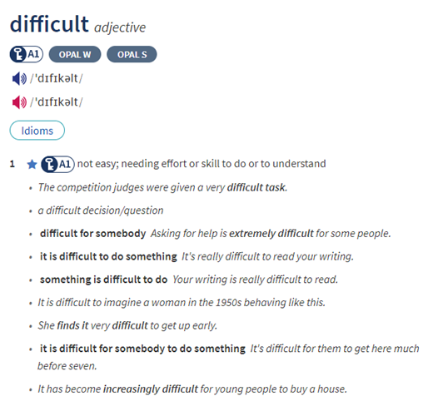
Adjectives (5) – how they look in the dictionary
Adjectives are indicated by the letters adj. They appear only in their BASIC form.
See, for example:

Slide 24
Adjectives (6) – common endings (suffixes)
Some of the most common adjective suffixes are:
-(t)ive - as in native, possessive, active
- able/ible – as in probable, possible
- ous – as in famous, tremendous
- ant/-ent – as in important, different
- (c)al - as in natural, tropical
- ic – as in basic
- ful / -less careful / careless, harmful/ harmless
**Can you think of additional examples for each ending?

Slide 25
Adjectives (7) – Identifying adjectives in a passage
Now let us read the first paragraph of the text “The World Language” for the third time.
This time, please mark all adjectives.
“On the estimates of David Crystal, a British expert, some 350 m people speak English as their first language. Between 250 m and 350 m, do or can use it as a second language. And elsewhere? That is a heroic guess, and it largely depends on how you define "can". Let us be bold: in all, 20-­25% of earth's 6 billion people can use English .”
For each adjective, state which noun it describes.

Slide 26
Noun compounds
Adjectives are not the only part of speech which can modify a noun.
Quite often, a noun may be described using another noun which precedes it.
The noun which functions as a modifier of the main noun usually appears in the singular form, even though it might refer to a plural quantity.
E.g., an apple tree – where the main noun is ‘tree’ and the modifying one is ‘apple’.
The noun ‘apple’ appears in the singular form though the tree probably yields more than one apple.
Similarly, we say ‘a two-year boy’, ‘six million people’, etc.

Slide 27
Adverbs (1)
* Adverbs are words that modify – or describe – one of the following parts of speech/ structures:
a. a verb of action:
E.g., She speaks Hebrew fluently. [often answering the question ‘how’].
b. an adjective:
E.g., Her Hebrew is extremely fluent.
c. another adverb:
E.g., She speaks Hebrew extremely fluently.
d. a whole clause:
E.g., Luckily, she speaks Hebrew fluently.

Slide 28
Adverbs (2) – form
Adverbs are often formed by adding the suffix –ly to an adjective.
E.g., quick (adj) -> quickly (adv)
Some common exceptions are the following:
Adverb | Adjective
well | good
fast | fast
hard hardly | hard
late lately | late

Slide 29
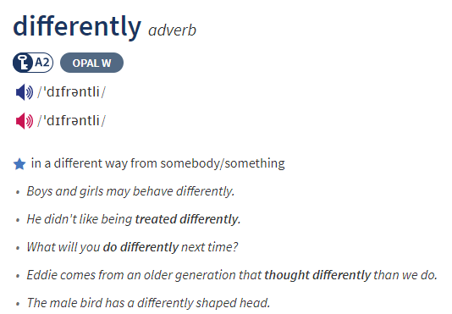
Adverbs (3) – how they look in the dictionary
Adverbs are indicated by the letters adv.
See, for example:
However, in some dictionaries, most adverbs appear at the end of their corresponding adjectives, just signifying them by adding the suffix –ly.

Slide 30
Word Families
Different parts of speech which belong to the same semantic stem form
a ‘word family’.
Let us study some examples:
adverb | adjective | noun | Verb
 | designed | design designer | design
scientifically | scientific | science scientist
really realistically | real realistic | reality realization | realize

